Slide 1

MCM
Contact Center Implementation- Training Document

Slide 2
Agenda
IVR Flow
Finesse Agent Screens
Finesse Supervisor Screens
End user Configuration
CUIC Reports

Slide 3
IVR Flow

Slide 4
Toll Free Number
The toll-free numbers provided are
8008884
8008885
While caller calls these toll free number Call will be transferred to IVR then it will be redirected to Agent based on his availability.

Slide 5
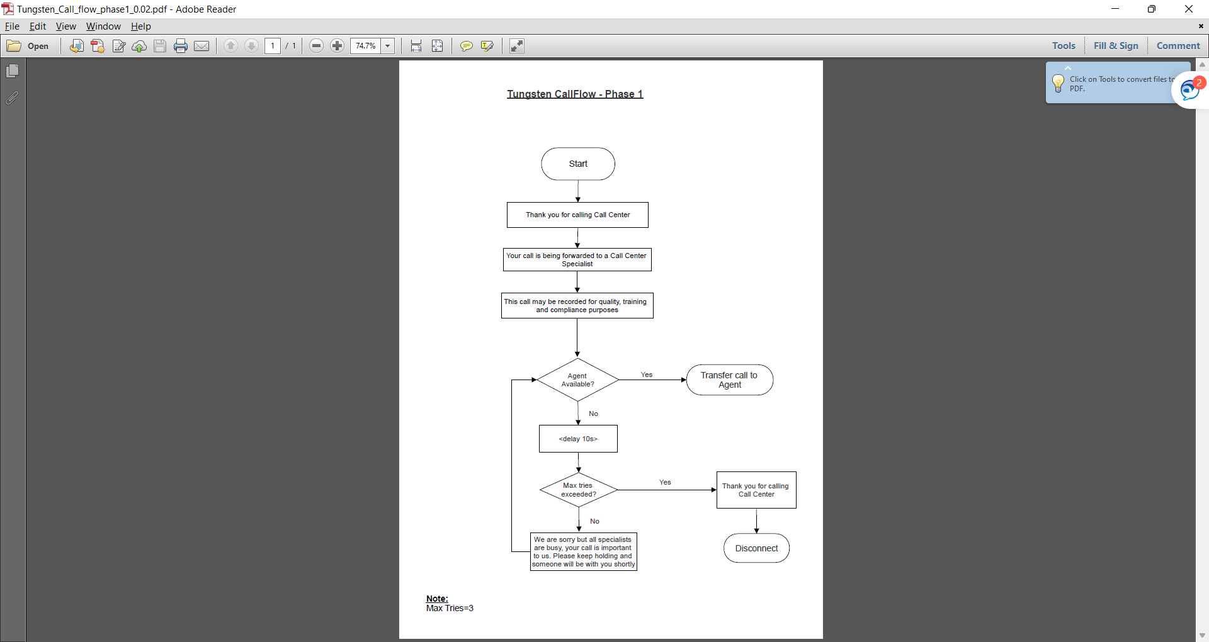
IVR Flow

Slide 6
Finesse Agent Screens

Slide 7
Finesse Screens
Agent Login
Agent- My History
Agent - My statistics
Change status–Ready , not ready
Make calls
Agent Logout

Slide 8
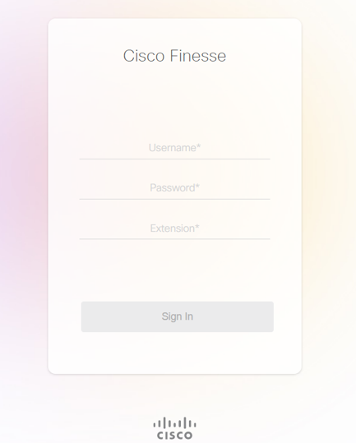
Finesse Login
Agent / Supervisor can Login to Finesse Desktop by providing the finesse Desktop URL by providing username, password and Extension

Slide 9
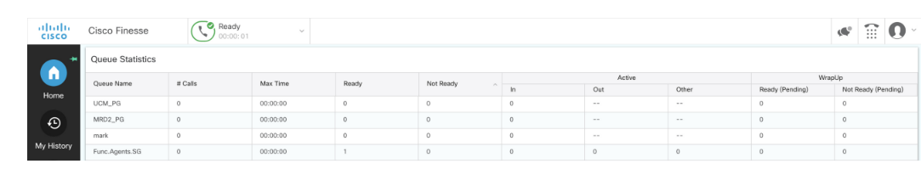
Finesse Agent Screen
Following is the initial screen when agent logs in. The initial status is “Not Ready”

Slide 10
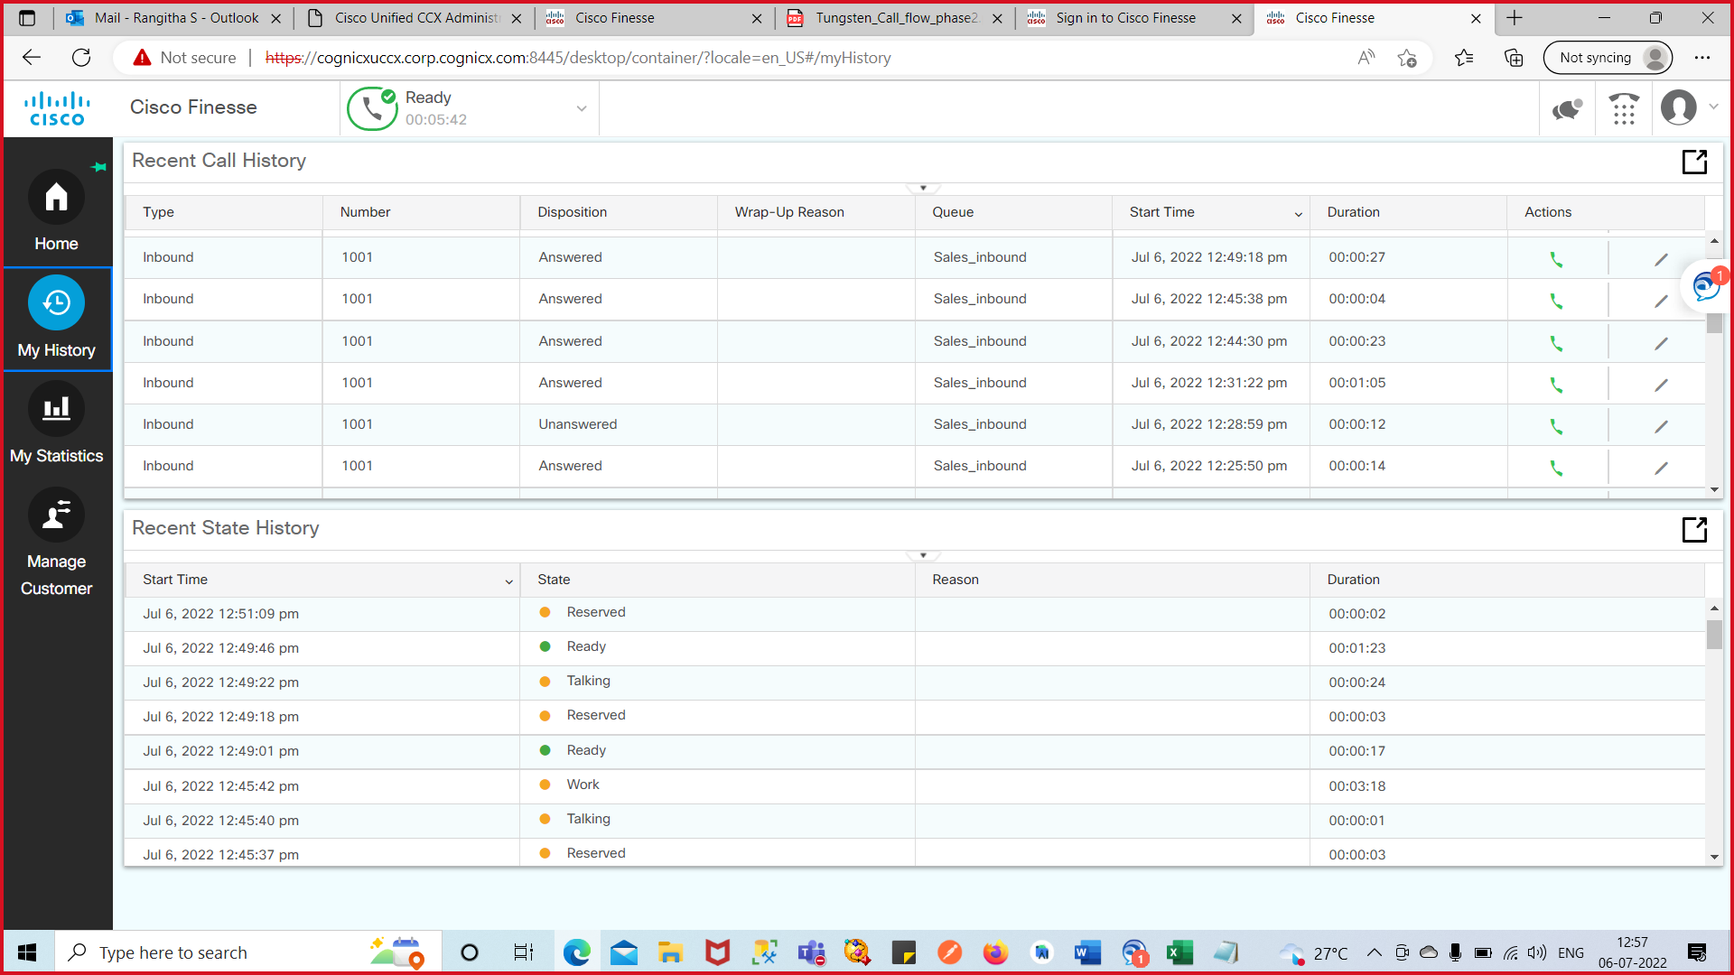
Finesse Agent Screen – My History
The My History screen has two parts:
Recent Call History [ list all incoming and outgoing calls since midnight]
Recent State History [list all your state changes since midnight]

Slide 11
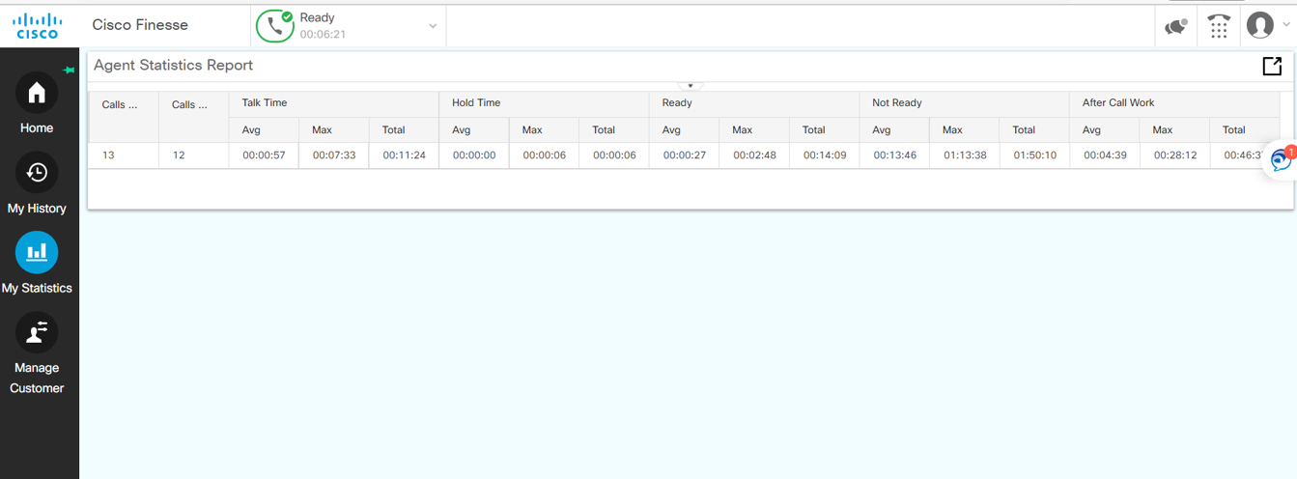
Finesse Agent Screen – My Statistics
My Statistics provides data on your agent telephone line since midnight

Slide 12
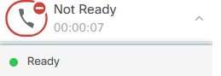
Changing states in Finesse
Agents manage their Ready (available for calls) and Not Ready (unavailable for calls) states
Note:
Supervisors can change agent state remotely
Ready
To accept incoming calls, select Ready from the Agent State drop-down
Reserved, Talking, and Wrap-Up
These are automatic state changes. Reserved is only active when the agent is receiving a call from the queue

Slide 13
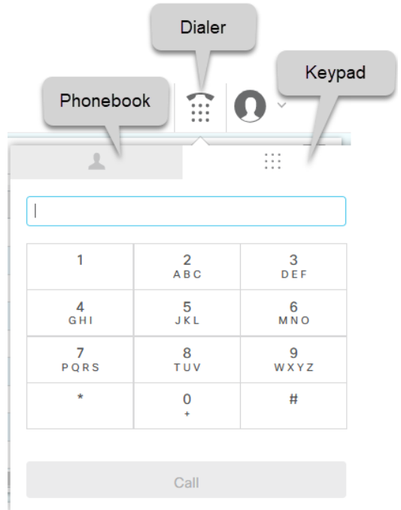
Making Calls in Finesse
By using Finesse for your outgoing calls, you will have access to your team's phonebook.
You can dial by manual entry or the phonebook.
For both methods, you will need to select the Dialer icon from the top row.

Slide 14
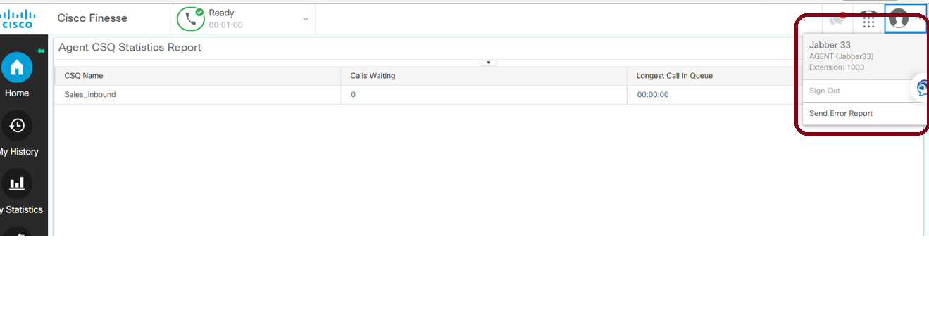
Finesse Logout
Make your self not ready
Go to the identity icon in the right corner of the Finesse Desktop and choose sign out.

Slide 15
Finesse Supervisor Screens

Slide 16
Finesse Supervisor Screens
Supervisor Login
Supervisor – Manage Team
Supervisor - My History
Supervisor - Queue Data
Supervisor – Team Data

Slide 17
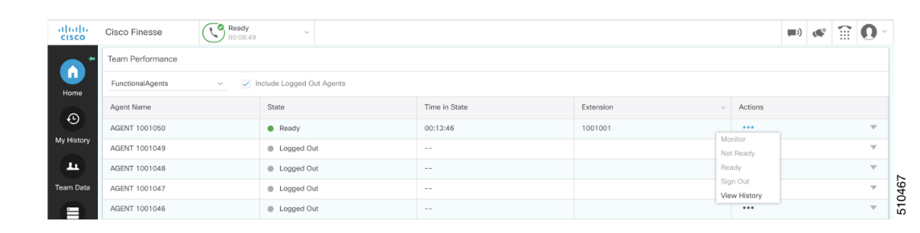
Supervisor Login
Supervisor can Login to Finesse Desktop by providing the finesse Desktop URL and his supervisor Credentials
Below are the different gadgets available for a Supervisor
Manage Team
My History
Team Data
Queue Data

Slide 18
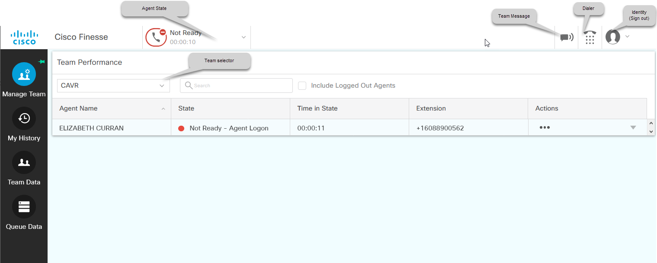
Supervisor – Manage Team
Supervisor can able to view/monitor the Agents State (Ready, not ready, talking along with the time state).
Note: If they want to view the details of the LOGGED-OUT agents then they can select the INCLUDE LOGGED OUT AGENTS checkbox
They can view their desktop by selecting the START MONITORING button.

Slide 19
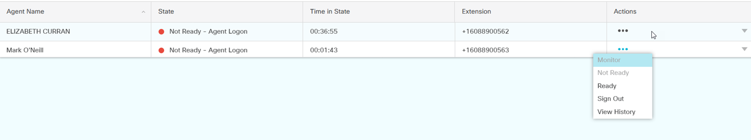
Supervisor – Manage Team (contd..)
3. They can also see all the call history and login history in the below sections.
4. The Supervisor can also make calls using the dial pad that is displayed in the screen.
5. The supervisor will also have the option to select specific contacts from the pre-defined list and dial their number.
6. To Change the status of the agent Go to the Actions column and click the three dots on the appropriate agent. Select the desired action. The available actions will vary depending on the state of the agents.

Slide 20
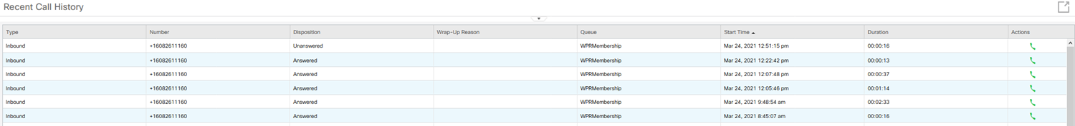
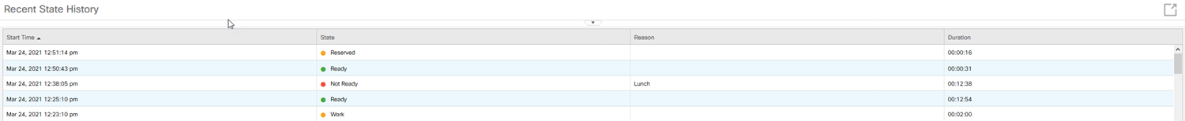
Supervisor – My History
The My History screen has two parts:
Recent Call History [list all incoming and outgoing calls since midnight]
Recent State History [The Recent State History will list all your state changes since midnight.]

Slide 21
Supervisor- Queue Data Tab
To get the voice CSQ Summary Report, click the Queue Data icon from the left navigation in Finesse. The report will show data from midnight on that day.
Supervisor can view the CSQ status Like
Call waiting in queue
Agent logged in to that CSQ
Agent status (Ready, not ready, Break)

Slide 22
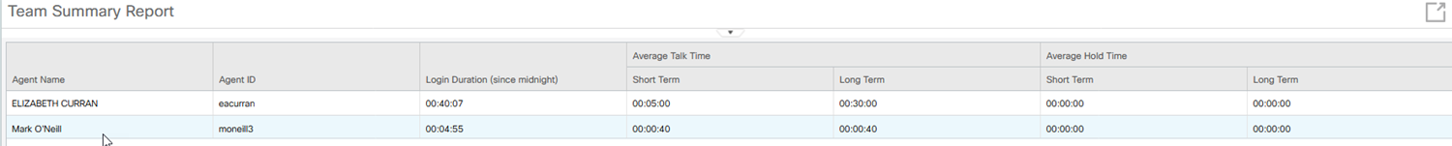
Supervisor - Team Data
To get to the Team Summary Report, click the Team Data icon from the left navigation in Finesse.
The report will show data from midnight on that day. This is a real-time report that will refresh every few seconds.

Slide 23
Finesse URL
URL Format- https://<FQDN>:<PORT NUMBER>/ desktop or cfadmin
Admin URL - https://<cognicxuccx.corp.cognicx.com>:<8445>/cfadmin
Desktop URL and Supervisor URL - https://<cognicxuccx.corp.cognicx.com>:<8445>/desktop
Note:
Above are sample URLS[ FQDN name should be replaced with actual UCCX server FQDN (hostname + Domain name)]
Agent and supervisor can login to Desktop by providing their credentials.

Slide 24
End User configuration

Slide 25
End user configuration
Configurations in CUCM
Phone configuration
End user configuration
Configuration in UCCX
3. Skill configuration
4. CSQ configuration

Slide 26
End user configuration - CUCM

Slide 27
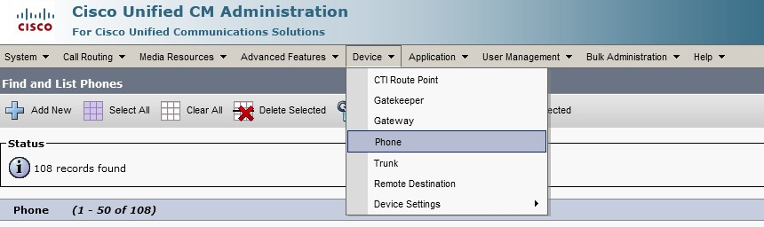
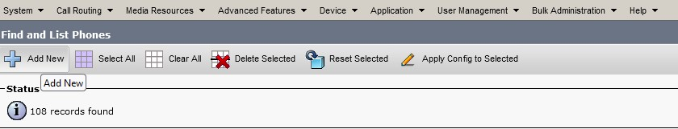
Phone Registration and End user Creation
Login to CUCM
Go to Device→ Phone
Press Add New

Slide 28
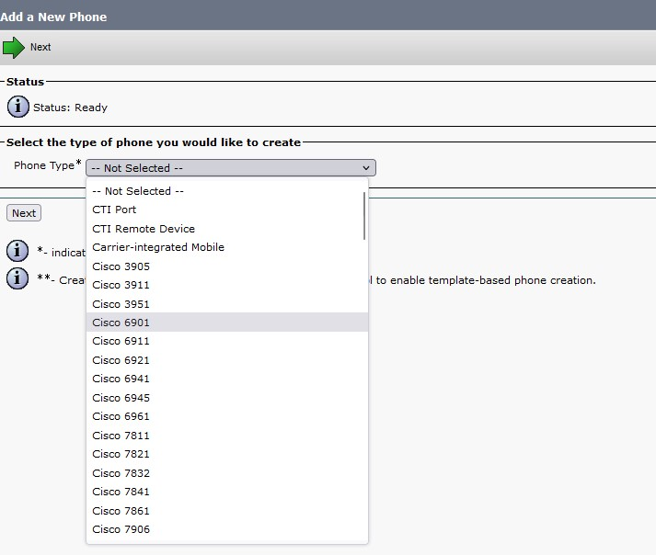
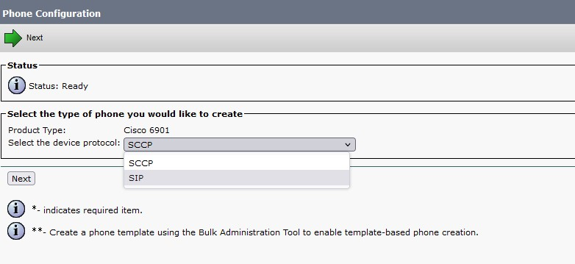
Phone Configuration – Add New Phone
Choose phone type and Protocol based on IP Phone

Slide 29
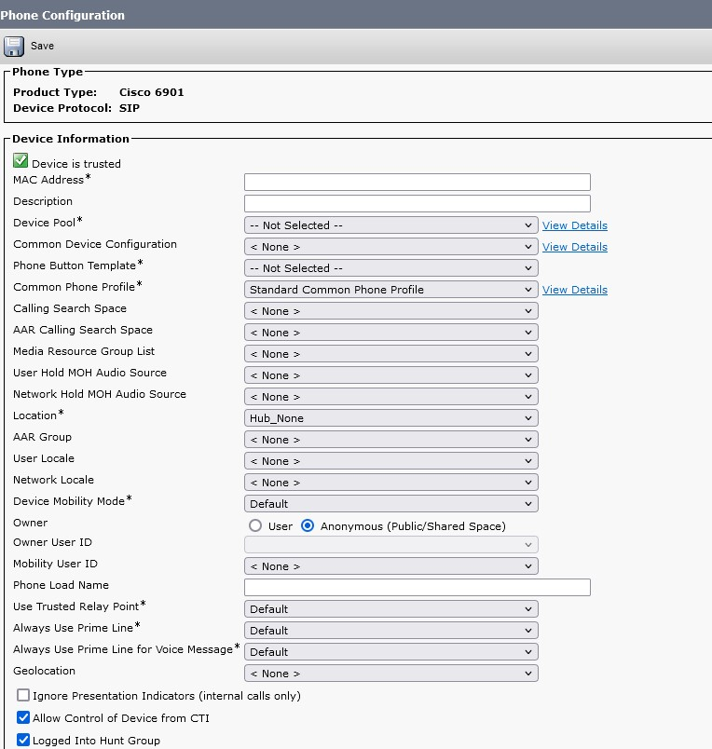
Phone Configuration
Following parameters are mandatory
Phone Device pool
Phone button template
Common phone profile
Device Security profile
Note: Choose Anonymous as Owner

Slide 30
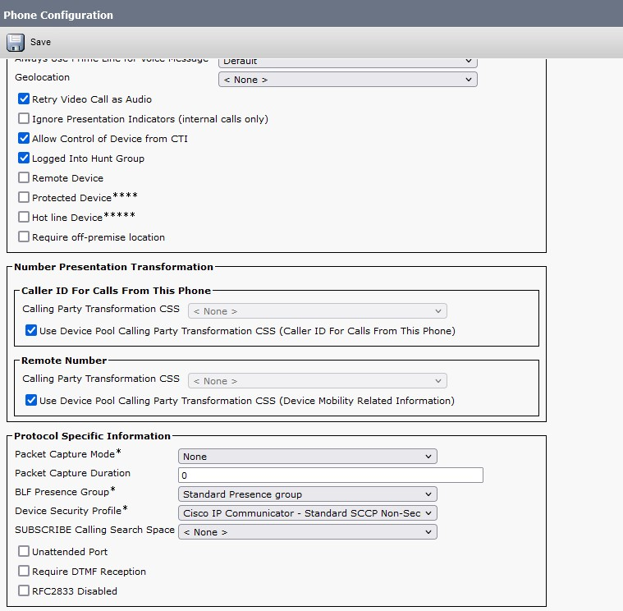
Phone Configuration

Slide 31
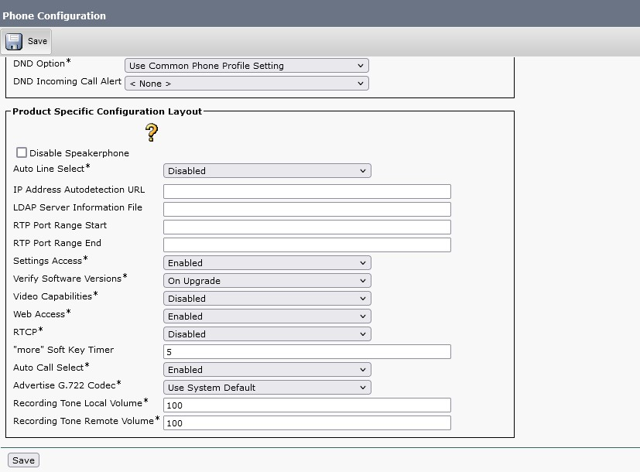
Phone Configuration
Click on Save and Apply config

Slide 32
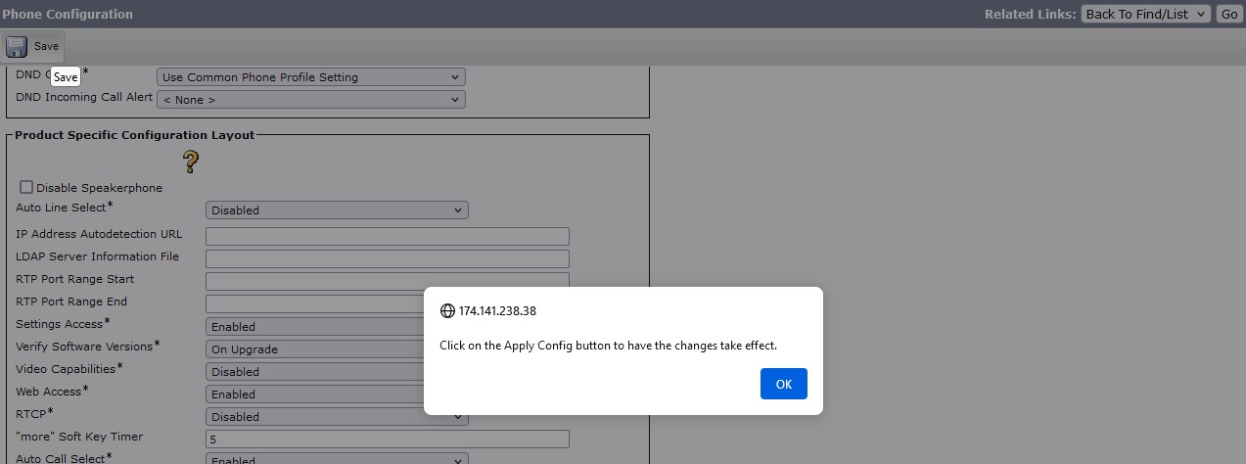
Phone Configuration

Slide 33
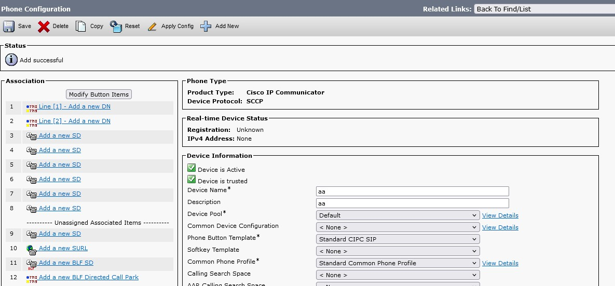
Adding Directory Number
Click on ‘Add a new DN’

Slide 34
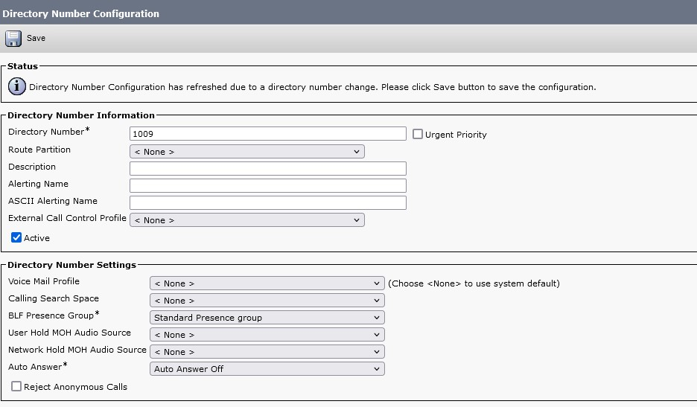
Adding Directory Number

Slide 35
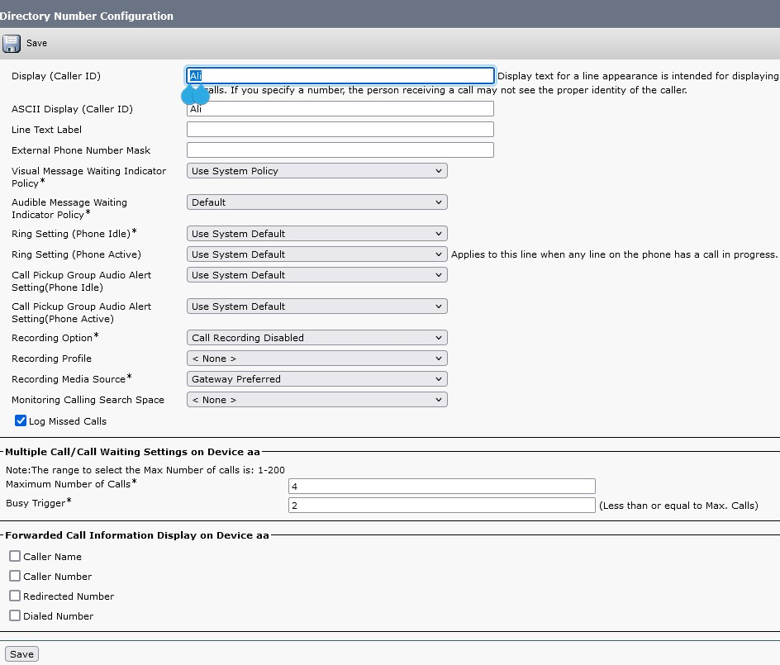
Adding Directory Number
Click save once enter the directory number and display name

Slide 36
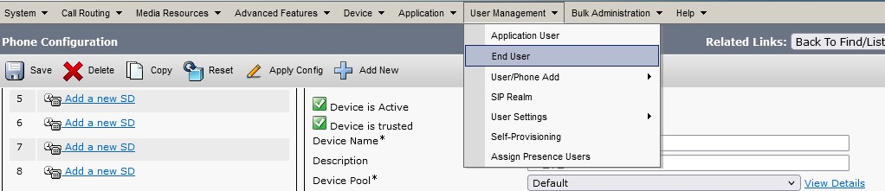
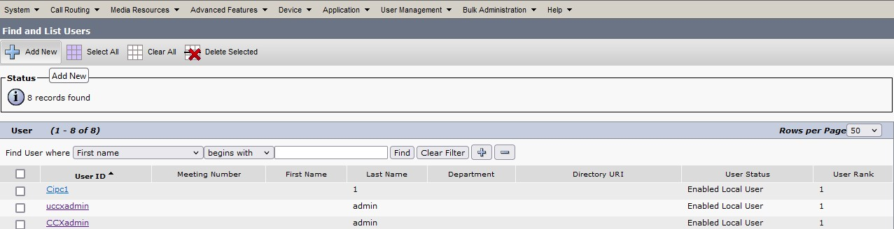
Add End user
User Management → End user
Click Add New

Slide 37
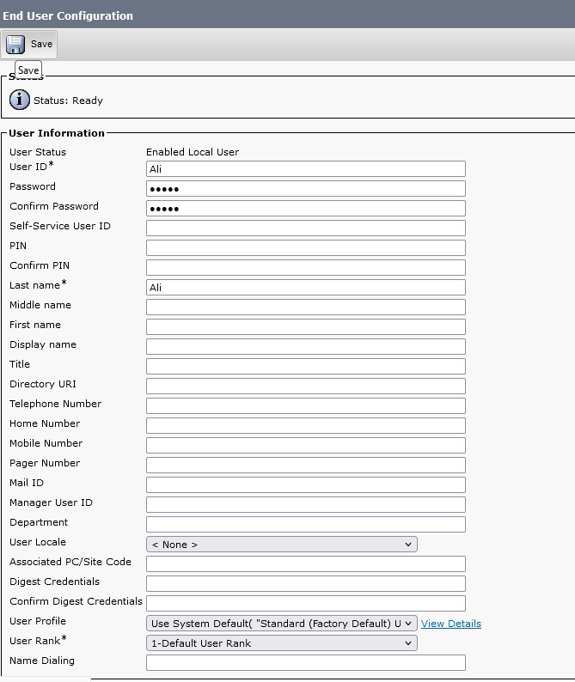
Add End user
Enter below Details
User ID
Name: first and last name
Password
Click save button

Slide 38
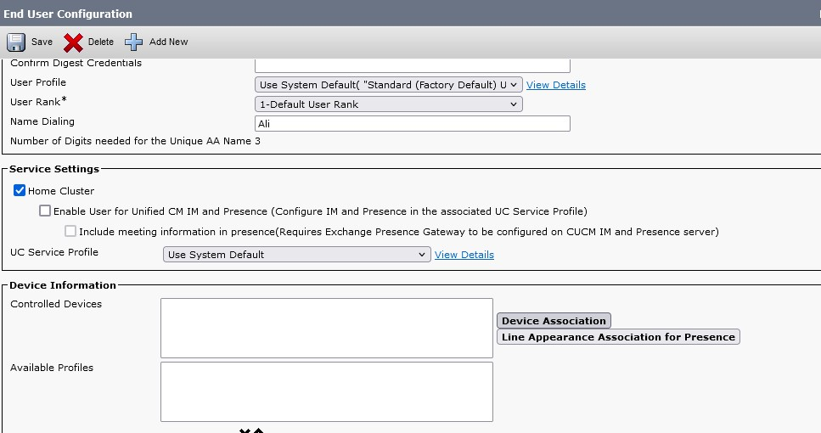
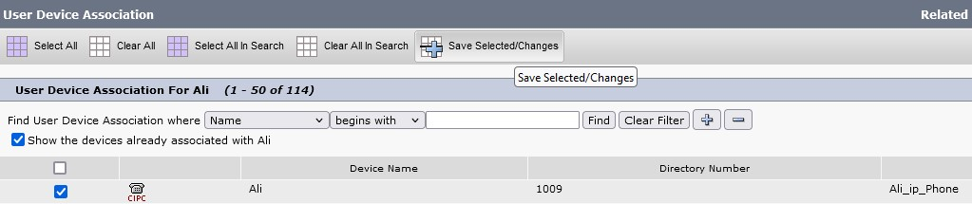
Add End User – Device Association
Click Device Association
Select Device

Slide 39
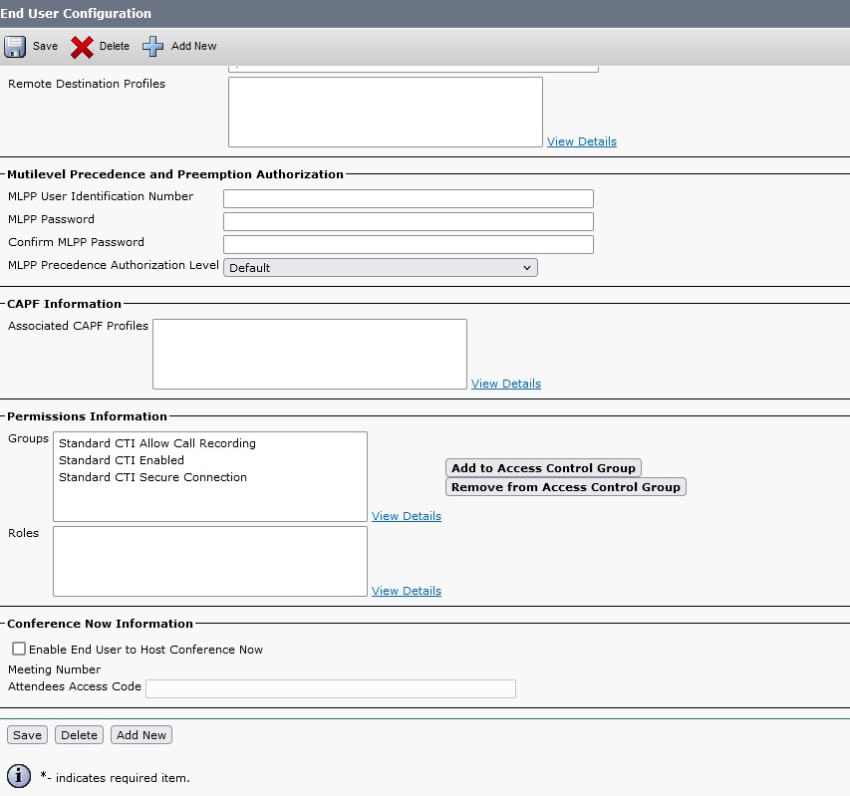
Add End User – Call Control Group
Call Control Group

Slide 40
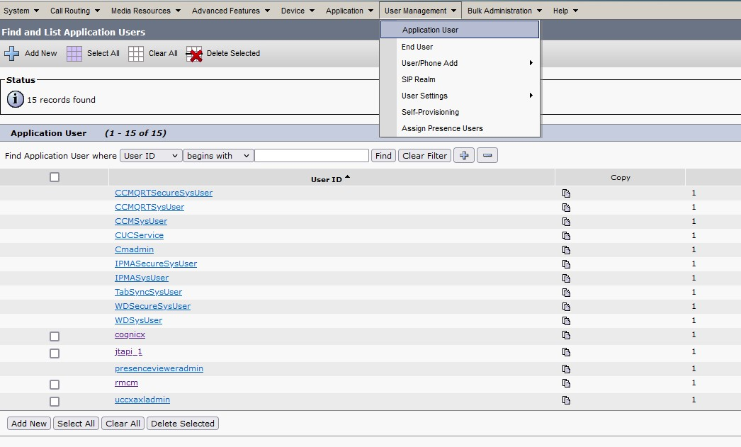
Add End User – Application user
Add the user to application user select rmcm and jtapi user

Slide 41
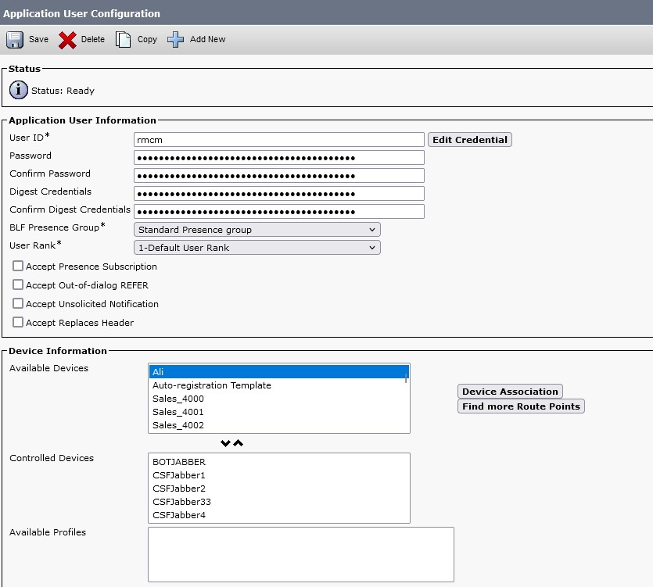
Add End User – Application user
Add Device from available Devices from “Controlled Devices”

Slide 42
End user configuration - UCCX

Slide 43
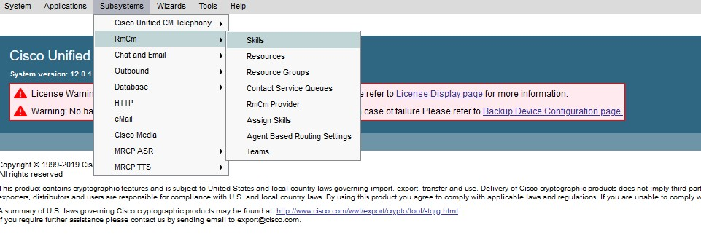
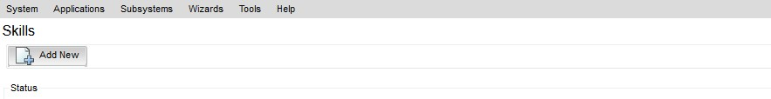
Add Skill
Login to UCCX
Subsystems→RmCm→Skills
Add New

Slide 44
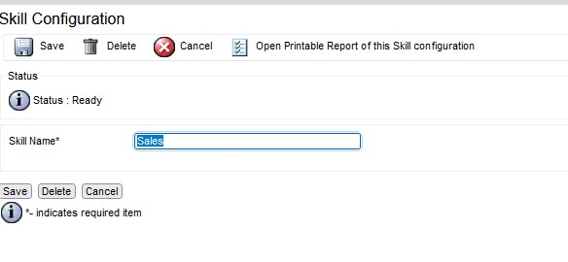
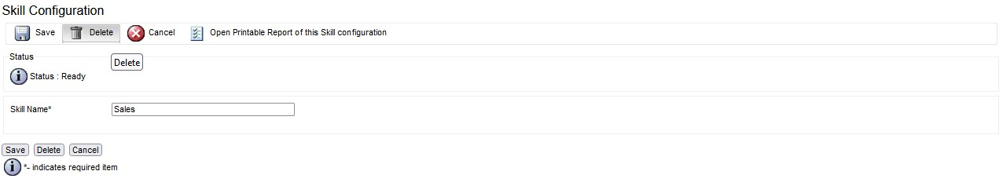
Add /Remove Skill
Add Skill name and Update
Click Delete To remove skill

Slide 45
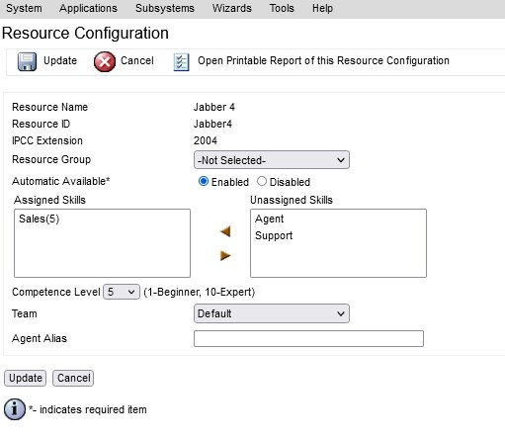
Add Skill to resource
Select Skill and Assign Skill

Slide 46
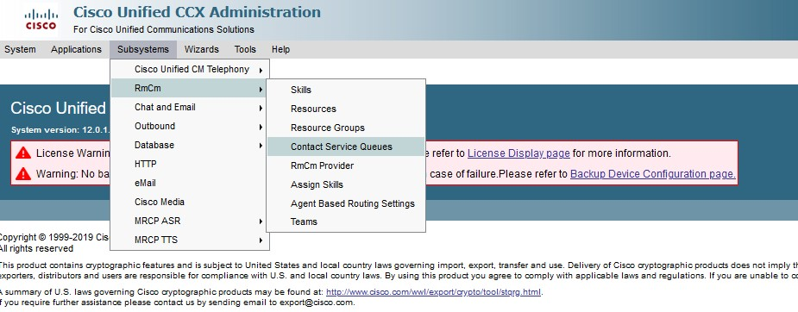
Add CSQ
Subsystem→RmCm→Contact Service Queues
Assign Skill

Slide 47
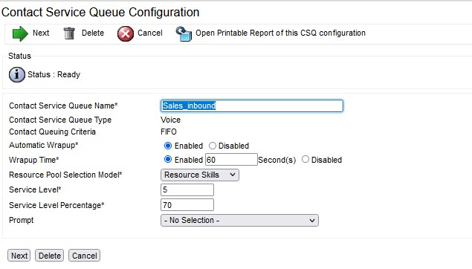
Add CSQ – Contact Service Queue Configuration
Subsystem → RmCm→ Contact Service Queues

Slide 48
CUIC Reporting

Slide 49
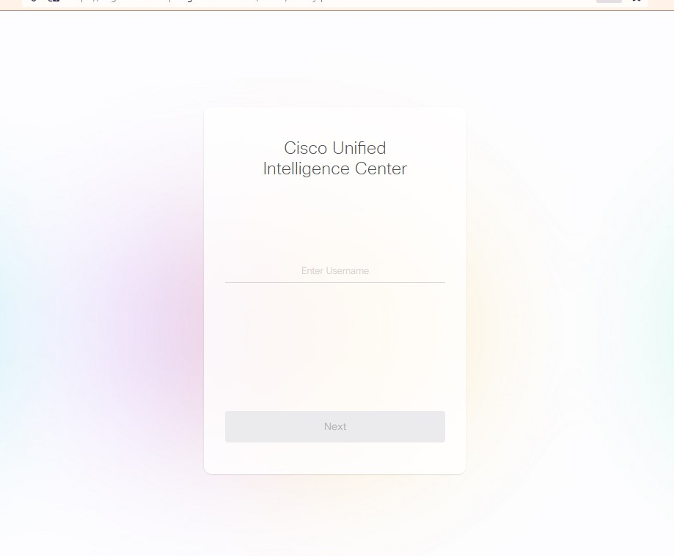
CUIC Login
CUIC Login URL: https://<FQDN>:<PORT NUMBER: 8444>/cuic

Slide 50
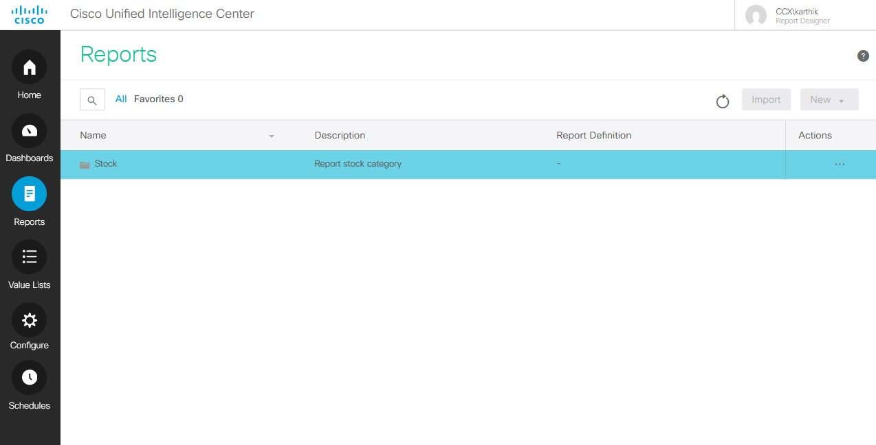
CUIC - Reports
Choose “Reports” option

Slide 51
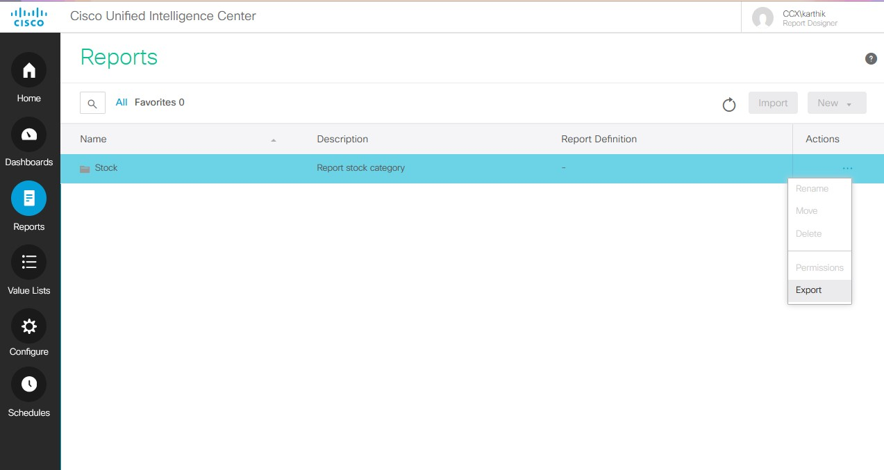
CUIC – Reports Export
Select stock and choose Export for exporting complete reports.

Slide 52
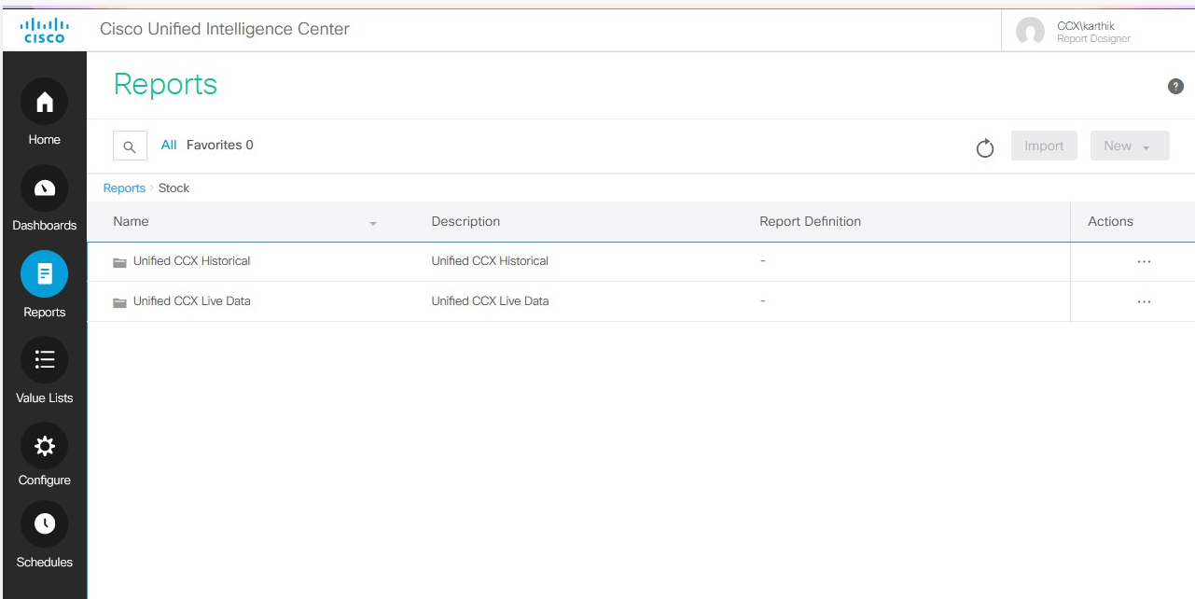
CUIC – Reports – Options
Click on Stock to view following 2 options
Unified CCX Historical
Unified CCX Live Data

Slide 53
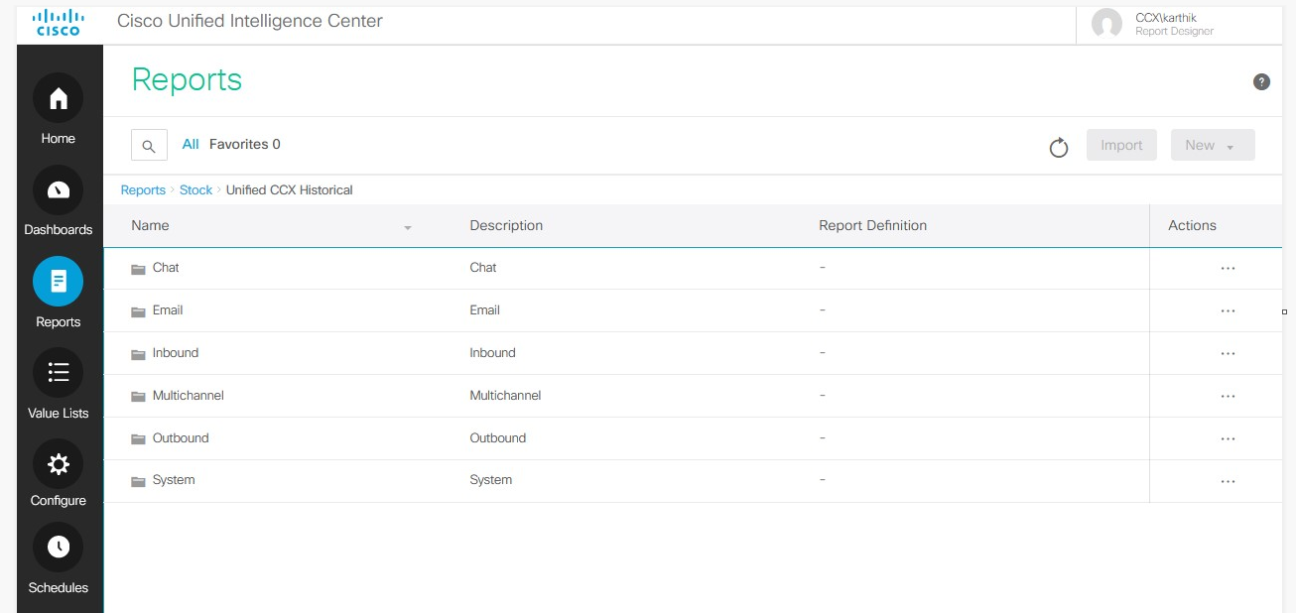
CUIC – Reports Historical Data
Historical Report have below options
-> Chat, Email, Inbound, Multichannel, Outbound, System

Slide 54
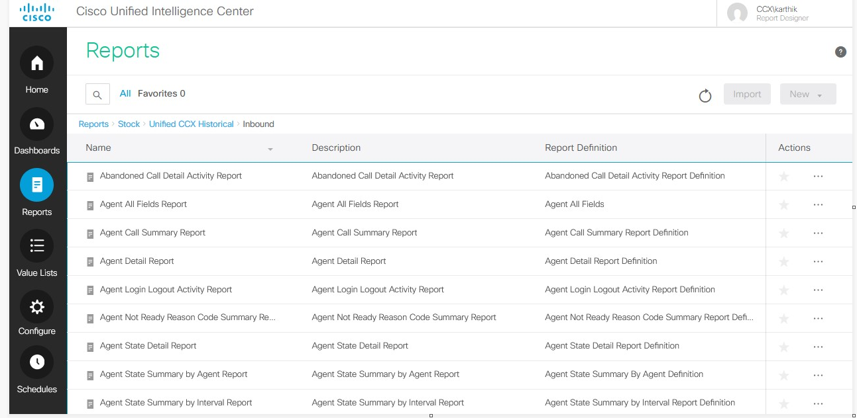
CUIC – Reports Historical Data -Inbound
Historical Report have below options
-> Inbound→ choose the report→ Export in Actions

Slide 55
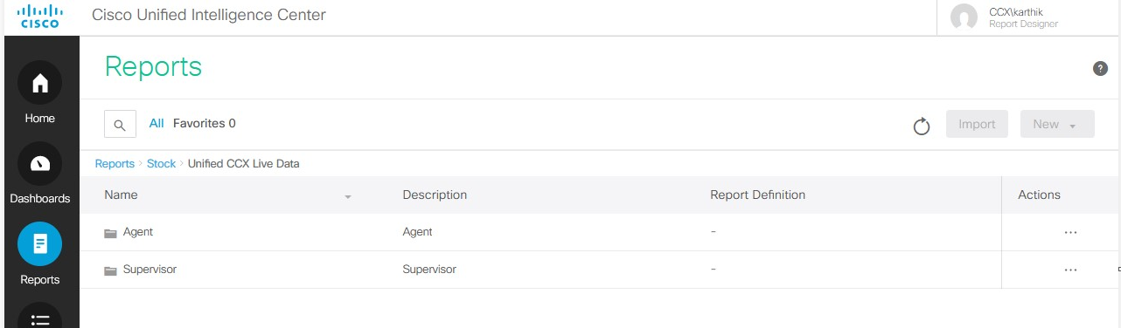
CUIC – Reports Live Data
Live Data Report have below options
Agent
Supervisor

Slide 56
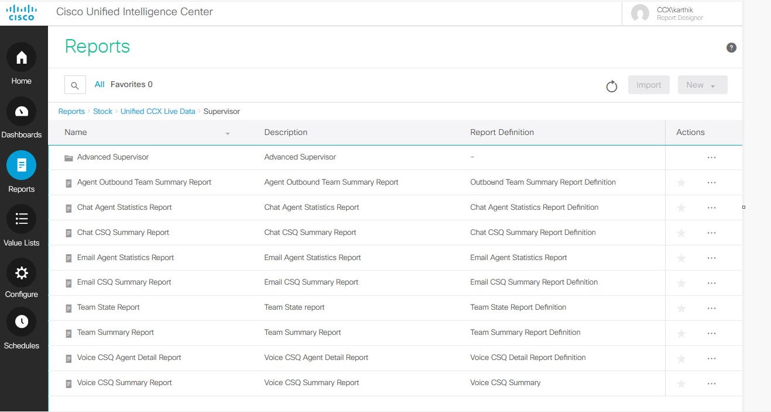
CUIC – Reports Live Data - Supervisor
Cisco CCX Live Data → Supervisor
Choose the required report
Click Export in Actions

Slide 57
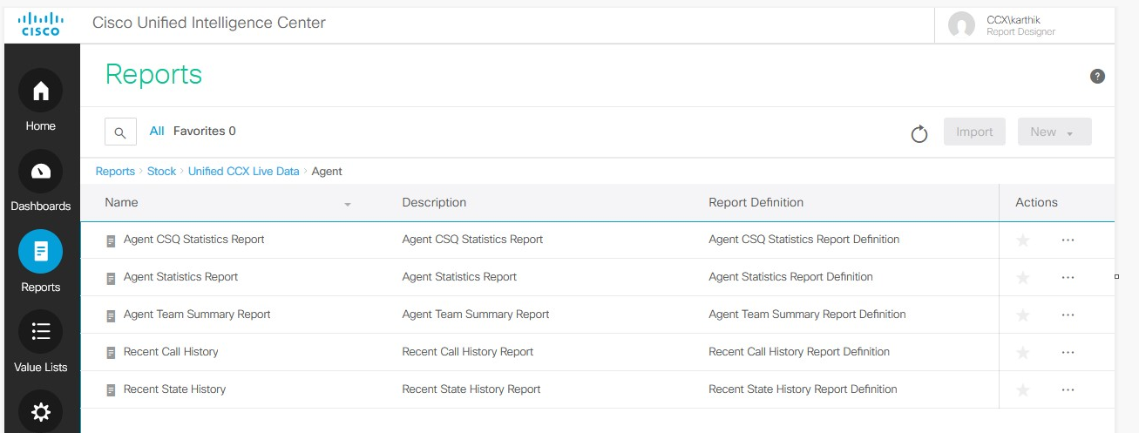
CUIC – Reports Live Data - Agent
Cisco CCX Live Data → Agent
Choose the required report
Click Export in Actions

Slide 58
Thank You!

